Slide 1

DSA0306-NATURAL LANGUAGE PROCESSTING
Code mixed slang detection and normalization using language identification , named entity recognition and transformer-based NLP
PRESENTED BY:
192424159-S.Padmaja
192424335- M. Rishitha
192425189-M.Manasa
192424276 - K. Vimala
GUIDED BY:
Dr. T. Kumaragurubaran

Slide 2


ABSTRACT
Detects and normalizes slang words in code-mixed multilingual text (e.g., English–Tamil, English–Hindi).
Uses Language Identification (LID) to identify the language of each word in the input text.
Applies Named Entity Recognition (NER) to recognize names of people, places, organizations, and preserve them during normalization.
Employs Transformer-based NLP models (e.g., BERT/mBERT/XLM-RoBERTa) to understand context and accurately detect slang expressions.
Converts informal slang and abbreviations into their standard language forms while preserving the original meaning.
Improves the quality of multilingual text, enhancing the performance of applications such as chatbots, sentiment analysis, machine translation, and text analytics.

Slide 3
INTRODUCTION
Code-mixing is the practice of using two or more languages within the same sentence or conversation, which is common on social media and messaging platforms.
Users frequently use slang, abbreviations, and informal spellings, making it difficult for NLP systems to correctly understand the text.
Traditional NLP models often struggle to process code-mixed text due to language switching and non-standard vocabulary.
The system converts informal code-mixed text into a standardized form while preserving the original meaning and named entities.
The proposed approach enhances the accuracy of downstream NLP applications such as sentiment analysis, chatbots, machine translation, and text classification.

Slide 4

PROBLEM STATEMENT
Social media users frequently communicate using code-mixed languages, slang, abbreviations, and non-standard spellings.
Traditional NLP systems struggle to understand such text due to language switching and informal vocabulary.
These challenges reduce the accuracy of downstream NLP tasks such as sentiment analysis, machine translation, and chatbot responses.
Therefore, there is a need for an intelligent system that can accurately detect and normalize code-mixed slang while preserving context and named entities using advanced Transformer-based NLP techniques.

Slide 5

OBJECTIVES
To detect slang words in code-mixed multilingual text.
To identify the language of each word using Language Identification (LID).
To recognize and preserve named entities using Named Entity Recognition (NER).
To normalize slang words into their standard language equivalents using Transformer-based NLP models.
To enhance the performance of NLP applications such as sentiment analysis, chatbots, machine translation, and text classification.

Slide 6
LITERATURE REVIEW
Author & Year | Title | Methodology | Findings | Limitations
Solorio et al. (2022) | Overview of Code-Mixed Language Processing | Language Identification using statistical models | Improved detection of languages in code-mixed text | Limited handling of slang and informal expressions
Devlin et al. (2024) | BERT: Pre-training of Deep Bidirectional Transformers | Transformer-based contextual language model | Achieved state-of-the-art performance in various NLP tasks | Requires large computational resources and training data
Conneau et al. (2020) | XLM-RoBERTa: Cross-Lingual Language Model | Multilingual Transformer model | Improved multilingual text understanding and cross-language learning | Performance decreases on low-resource languages
Akbik et al. (2023) | FLAIR: Contextual String Embeddings for NER | Named Entity Recognition using contextual embeddings | High accuracy in recognizing named entities | Less effective on noisy social media text
Liu et al. (2020) | Multilingual Slang Normalization using Deep Learning | Deep learning with contextual embeddings | Improved normalization of slang and abbreviations | Limited support for complex code-mixed multilingual text
Proposed Work | Code-Mixed Slang Detection and Normalization using Language Identification, Named Entity Recognition, and Transformer-Based NLP | Language Identification + NER + Transformer-based NLP | Detects code-mixed slang, preserves named entities, and normalizes text with high contextual accuracy | Aims to improve multilingual NLP applications and overcome existing limitations

Slide 7
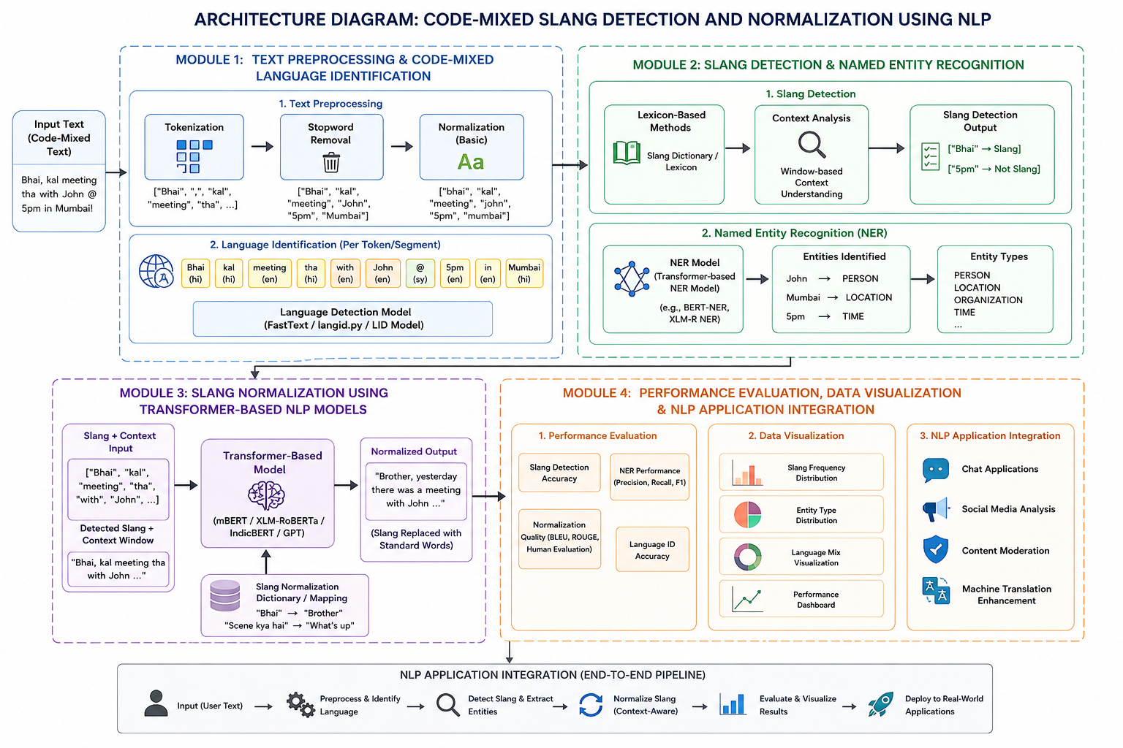

Slide 8
MODULE 1: Text Preprocessing and Code-Mixed Language Identification using Tokenization, Stopword Removal, and Language Detection
Collect input text from social media platforms, chat messages, online forums, and multilingual datasets containing code-mixed language.
Preprocess the text by removing punctuation marks, URLs, emojis, special symbols, repeated characters, and unnecessary white spaces to improve data quality.
Tokenize the text by splitting each sentence into individual words or tokens for further linguistic analysis.
Identify the language of each token using Language Identification (LID) techniques to classify words into languages such as English, Hindi, Tamil, Telugu, etc.
Output a cleaned, tokenized, and language-tagged dataset that serves as the input for slang detection and named entity recognition.

Slide 9
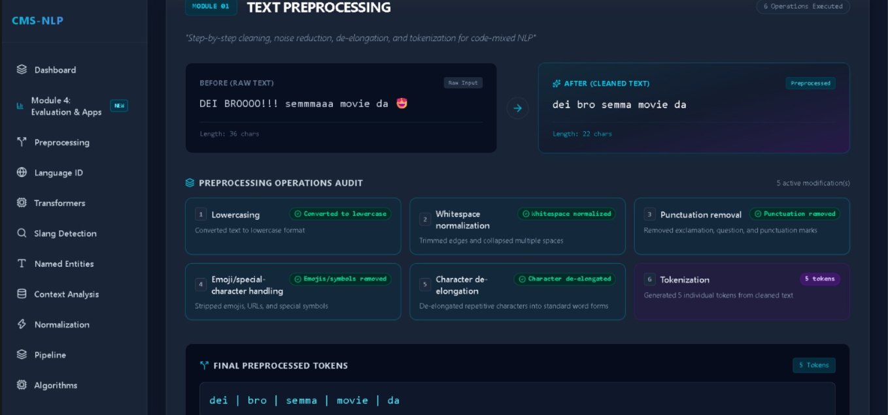
MODULE 1: Text Preprocessing and Code-Mixed Language Identification using Tokenization, Stopword Removal, and Language Detection

Slide 10
MODULE 2: Slang Detection and Named Entity Recognition using Lexicon-Based Methods, NER Models, and Context Analysis
Detect slang words by comparing tokens with predefined slang dictionaries and multilingual lexical resources.
Identify abbreviations, internet slang using rule-based techniques and machine learning models.
Apply Named Entity Recognition (NER) to identify names of persons, organizations, locations, dates, and other important entities within the text.
Analyze the surrounding context to distinguish slang words from named entities and ensure accurate classification.
Output annotated text with language labels, detected slang terms, and recognized named entities for the normalization stage.

Slide 11
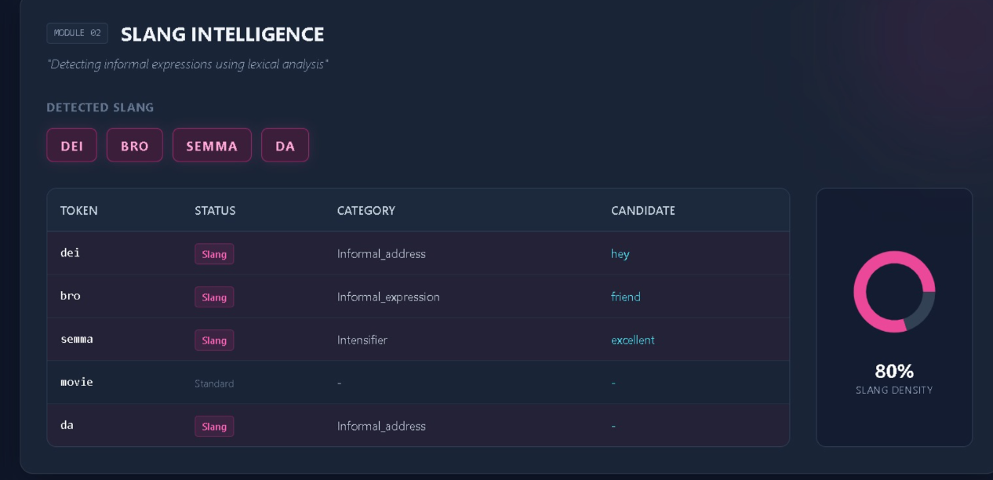
MODULE 2: Slang Detection and Named Entity Recognition using Lexicon-Based Methods, NER Models, and Context Analysis

Slide 12
MODULE 3: Slang Normalization using Transformer-Based NLP Models and Context-Aware Language Processing
Normalize detected slang words by mapping them to their standard language equivalents using multilingual slang dictionaries.
Use Transformer-based NLP models (such as BERT, mBERT, or XLM-RoBERTa) to understand sentence context and predict the most appropriate replacement words.
Preserve named entities while replacing only slang expressions to maintain the original meaning of the sentence.
Generate grammatically correct and standardized text by correcting informal spellings, abbreviations, and code-mixed expressions.
Output normalized multilingual text that is clear, readable, and suitable for downstream NLP applications.

Slide 13
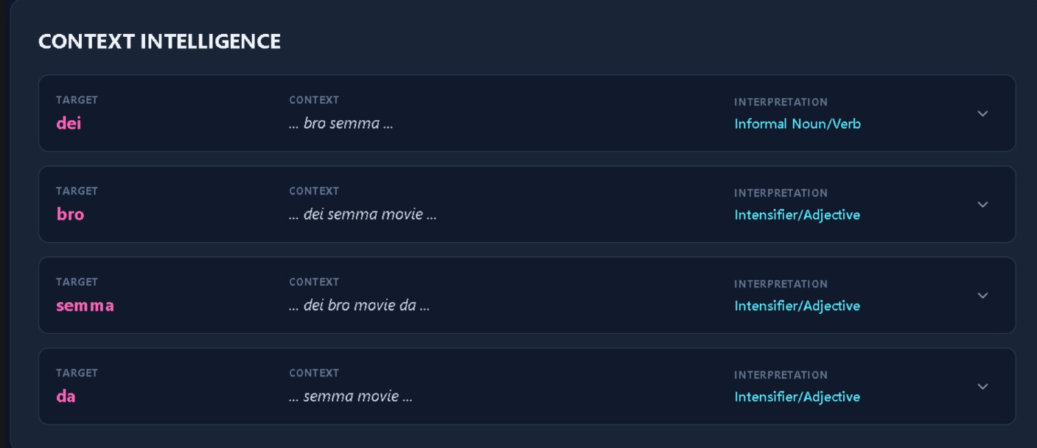
MODULE 3: Slang Normalization using Transformer-Based NLP Models and Context-Aware Language Processing

Slide 14
MODULE 4: Performance Evaluation, Data Visualization and NLP Application Integration
Evaluate the proposed slang detection and normalization model using Accuracy, Precision, Recall, and F1-Score.
Compare original and normalized text to measure readability, consistency, and semantic preservation.
Visualize NLP performance using bar charts, line graphs, confusion matrices, word clouds, and comparative plots.
Compare different NLP techniques and visualize slang frequency, language distribution, and model performance.
Output an efficient and scalable code-mixed slang normalization framework that enhances multilingual NLP performance across real-world applications.

Slide 15
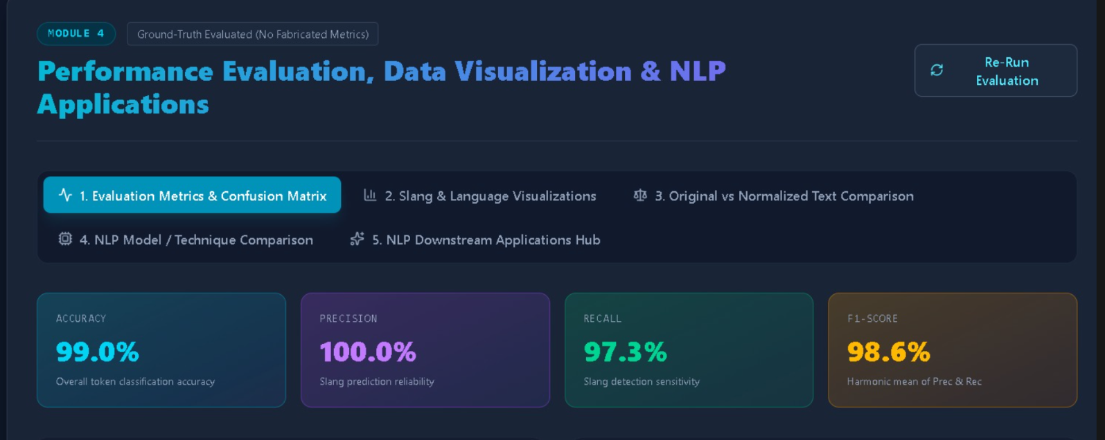
MODULE 4: Performance Evaluation, Data Visualization and NLP Application Integration

Slide 16
CONCLUSION
Developed an effective framework for detecting and normalizing slang in code-mixed multilingual text using advanced NLP techniques.
Successfully integrated Language Identification (LID), Named Entity Recognition (NER), and Transformer-based NLP models for accurate text processing.
Preserved the original meaning of sentences while converting informal slang and abbreviations into their standard forms.
Improved the quality, readability, and consistency of multilingual text for better language understanding.
Enhanced the performance of downstream NLP applications such as sentiment analysis, chatbots, machine translation, and text classification.

Slide 17
References
Sheth, R., Sinha, S. R., Patil, M., Beniwal, H., & Singh, M. (2026). Beyond Monolingual Assumptions: A Survey on Code-Switched NLP in the Era of Large Language Models across Modalities. ACL 2026.
Upadhyay, A., Khatri, E., Singh, H. P., Mishra, S. K., & Rai, V. K. (2026). Span-level Target and Harmfulness Detection in Code-mixed Hinglish Using Cross-lingual and Multilingual Transformers. Expert Systems with Applications, 308, 131033.
Takawane, G., Phaltankar, A., Patwardhan, V., Patil, A., Joshi, R., & Takalikar, M. S. (2023). Leveraging Language Identification to Enhance Code-Mixed Text Classification.
Das, R., Ranjan, S., Pathak, S., & Jyothi, P. (2023). Improving Pretraining Techniques for Code-Switched NLP. Proceedings of ACL 2023, 1176–1191.
Rizqullah, R. D., & Budi, I. (2022). Text Normalization on Code-Mixed Twitter Text Using Language Detection. IEEE, 2022

Slide 18
THANK YOU !

